Slide 1
Inverts
Matthew Madsen

Slide 2
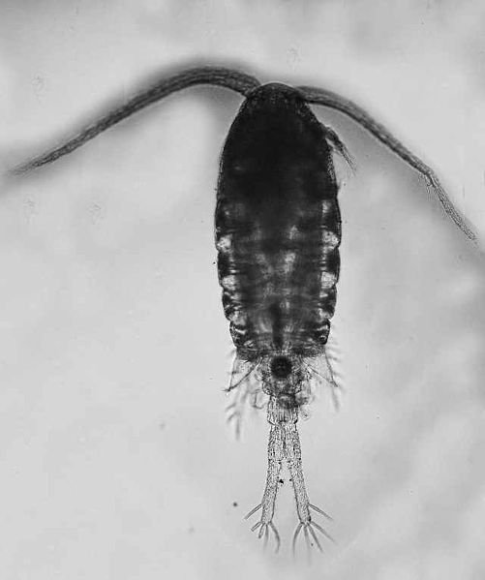
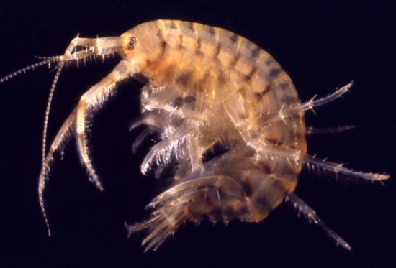
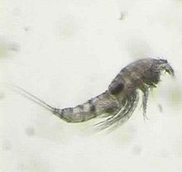
Why Invertebrate Analysis?
How does invert composition change over time?
Does eelgrass support more species? Role in ecosystem?
Potentially aids in understanding salmon gut content
http://invasions.si.edu/nemesis/calnemo/SpeciesSummary.jsp?TSN=85863
https://nas.er.usgs.gov/queries/SpeciesList.aspx?state=OH
https://en.wikipedia.org/wiki/Harpacticoida

Slide 3
Methods
Size fractioned samples (4mm, 1-4 mm, <1 mm)
ID with certainty to lowest taxonomic level
Count and ID 300 individuals per sample when possible
2 Replicates per Site
Notes:
Brought all the samples in, then I go through and size fraction with a stack of sieves 4mm, 1 mm and 250 µm. For the largest size fraction I count each above 4

Slide 4
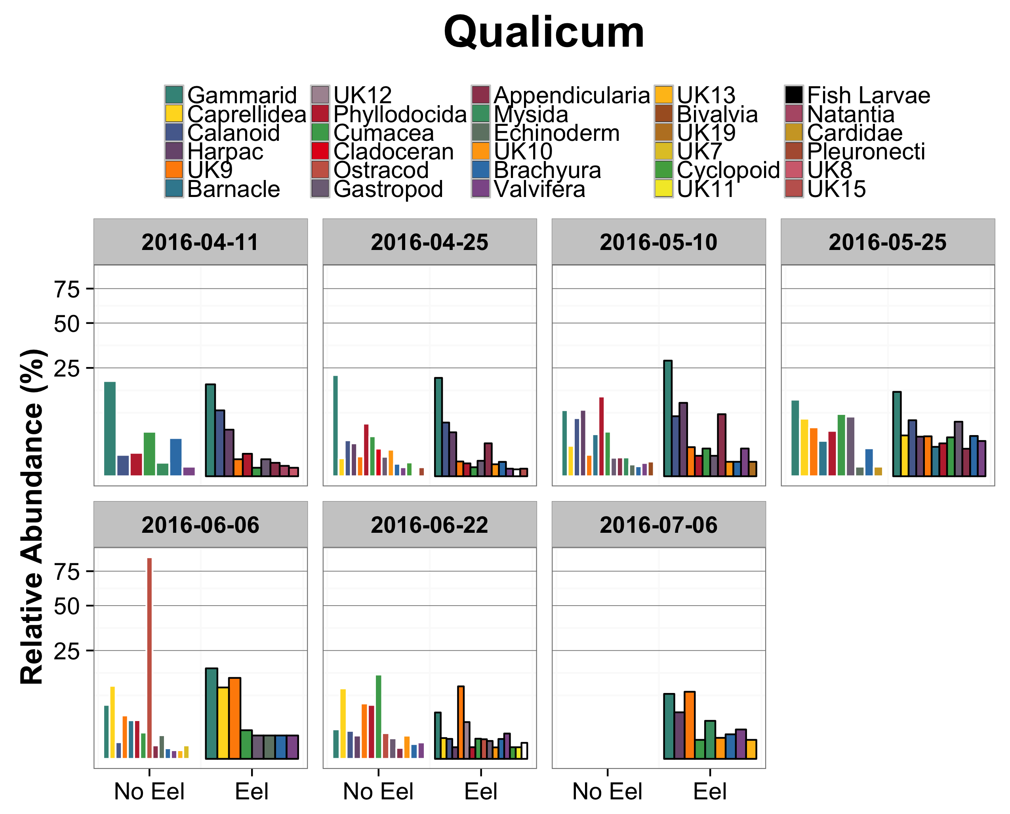

Slide 5
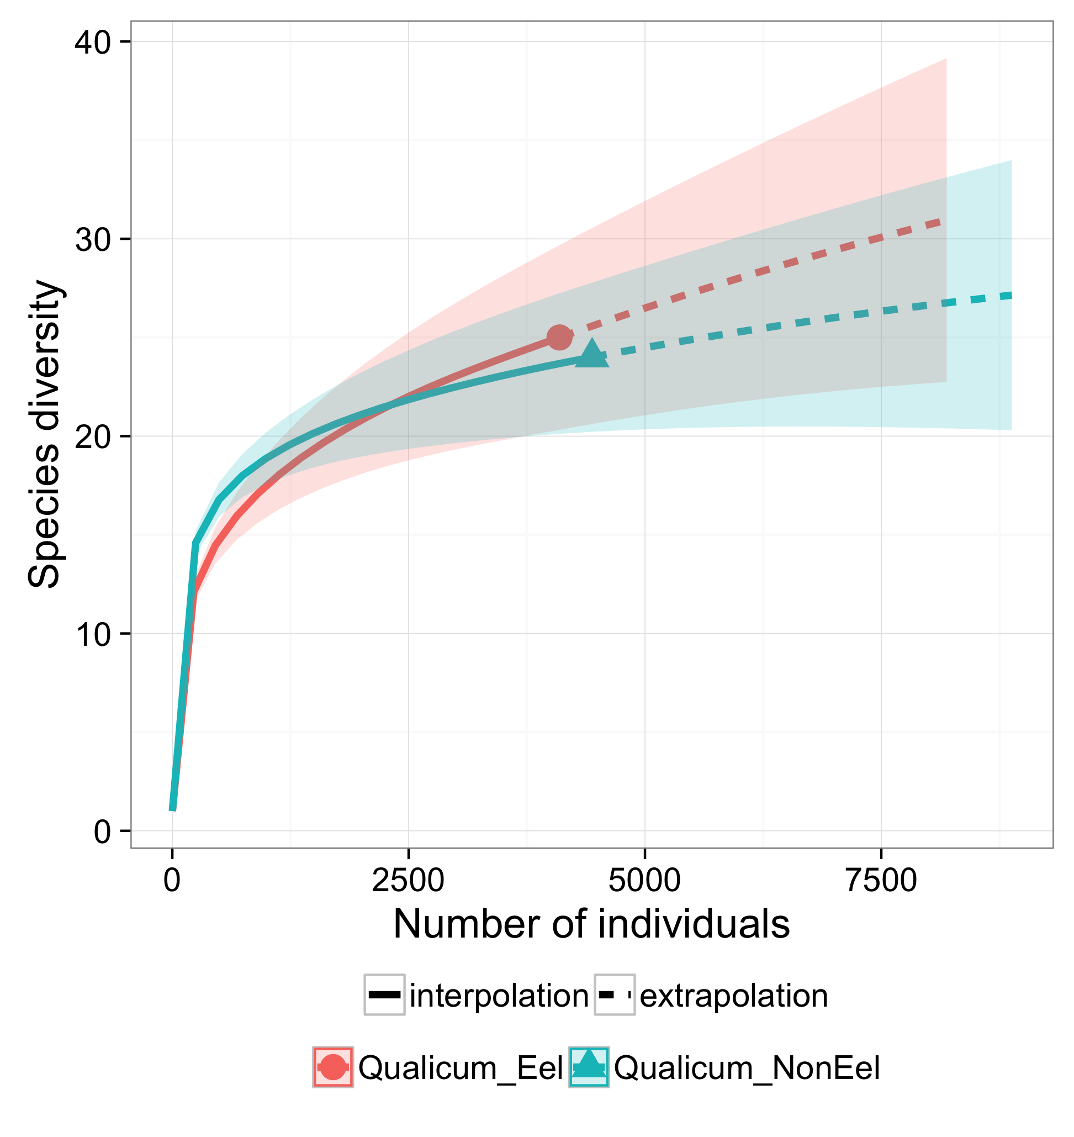
Notes:
Hill Number equal to 0 (species richness), bootstrap equals to 100. iNext package in R. Extrapolates on actual counts.

Slide 6
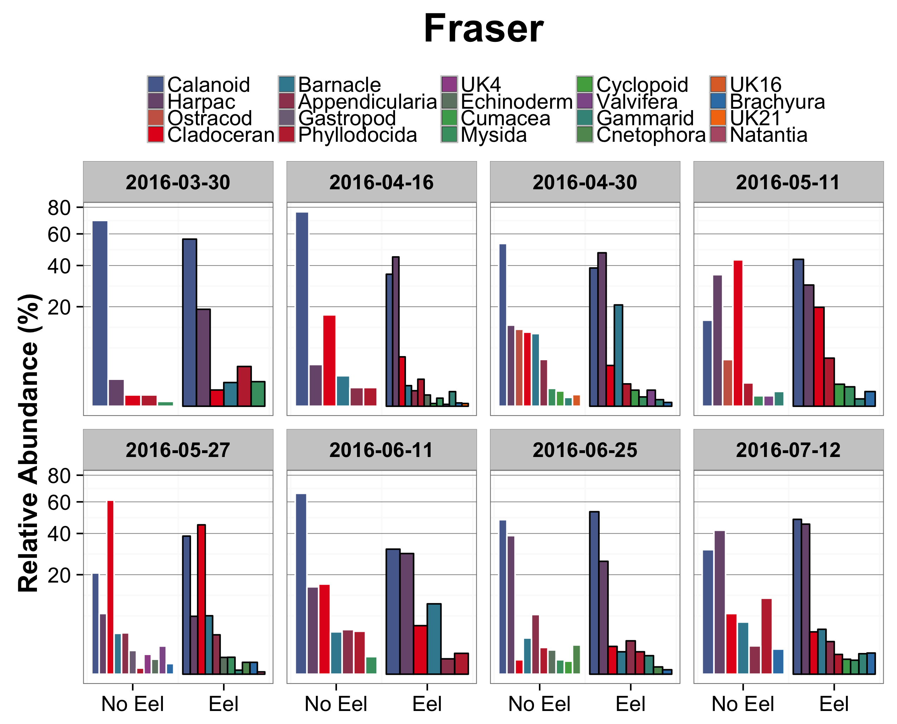

Slide 7
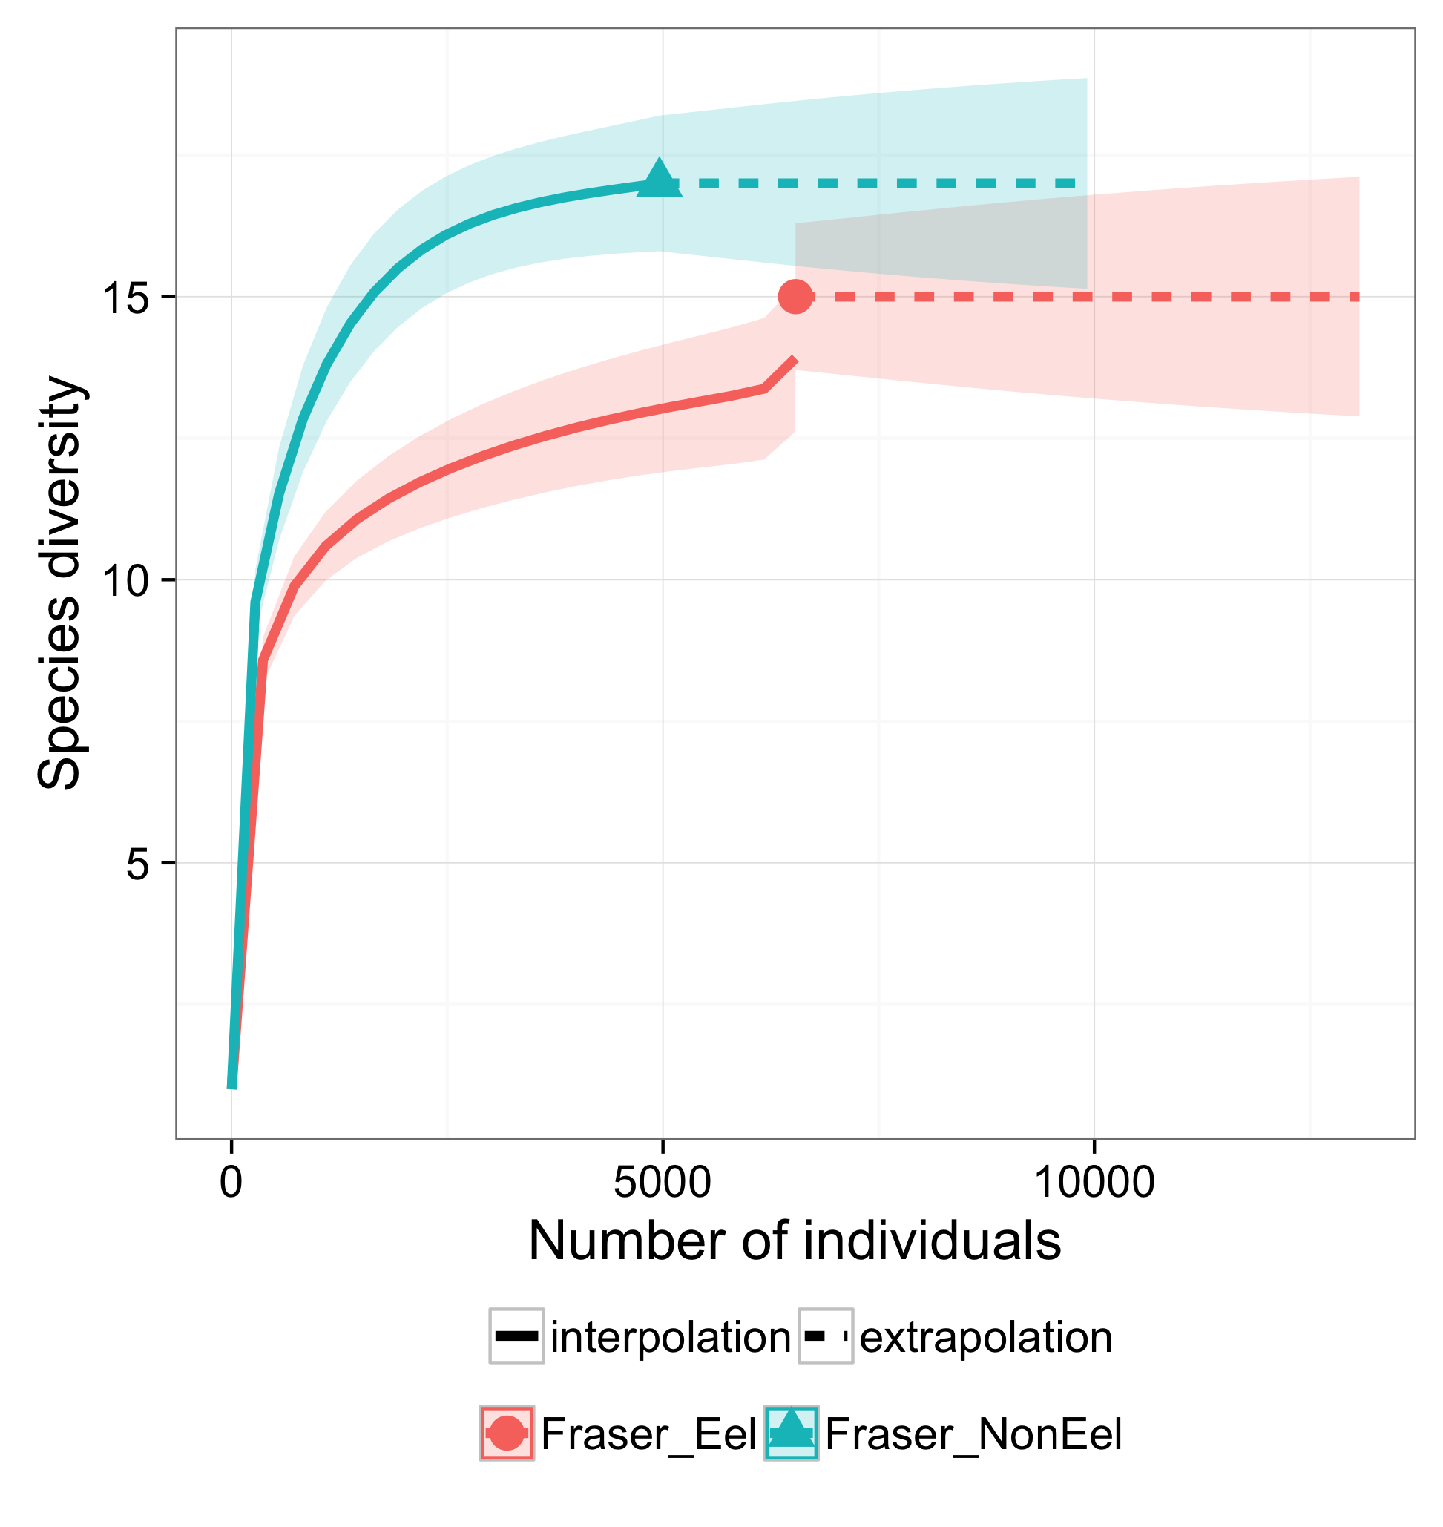

Slide 8
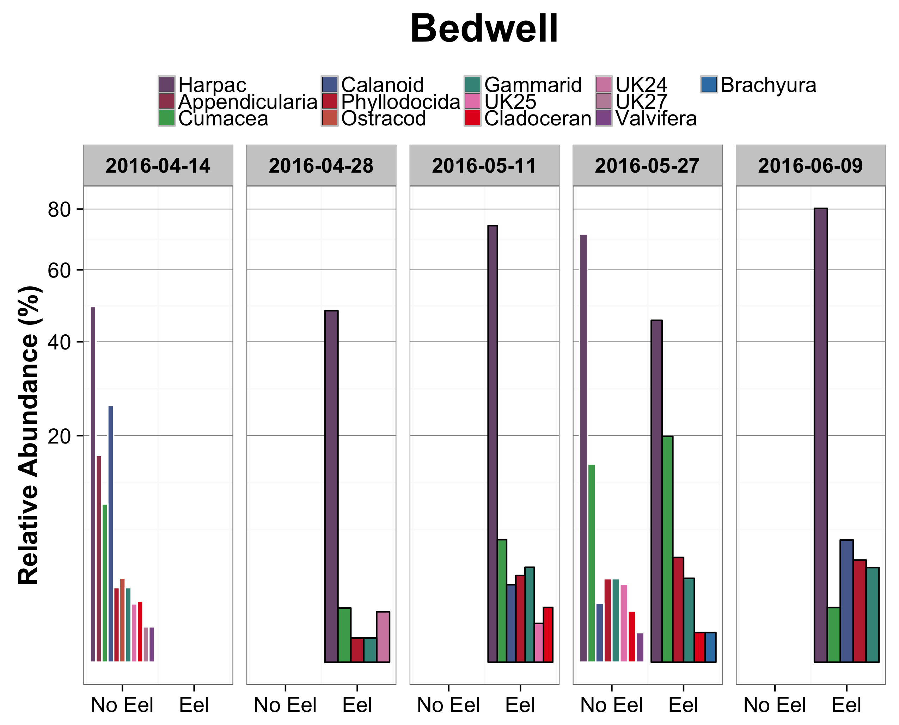

Slide 9
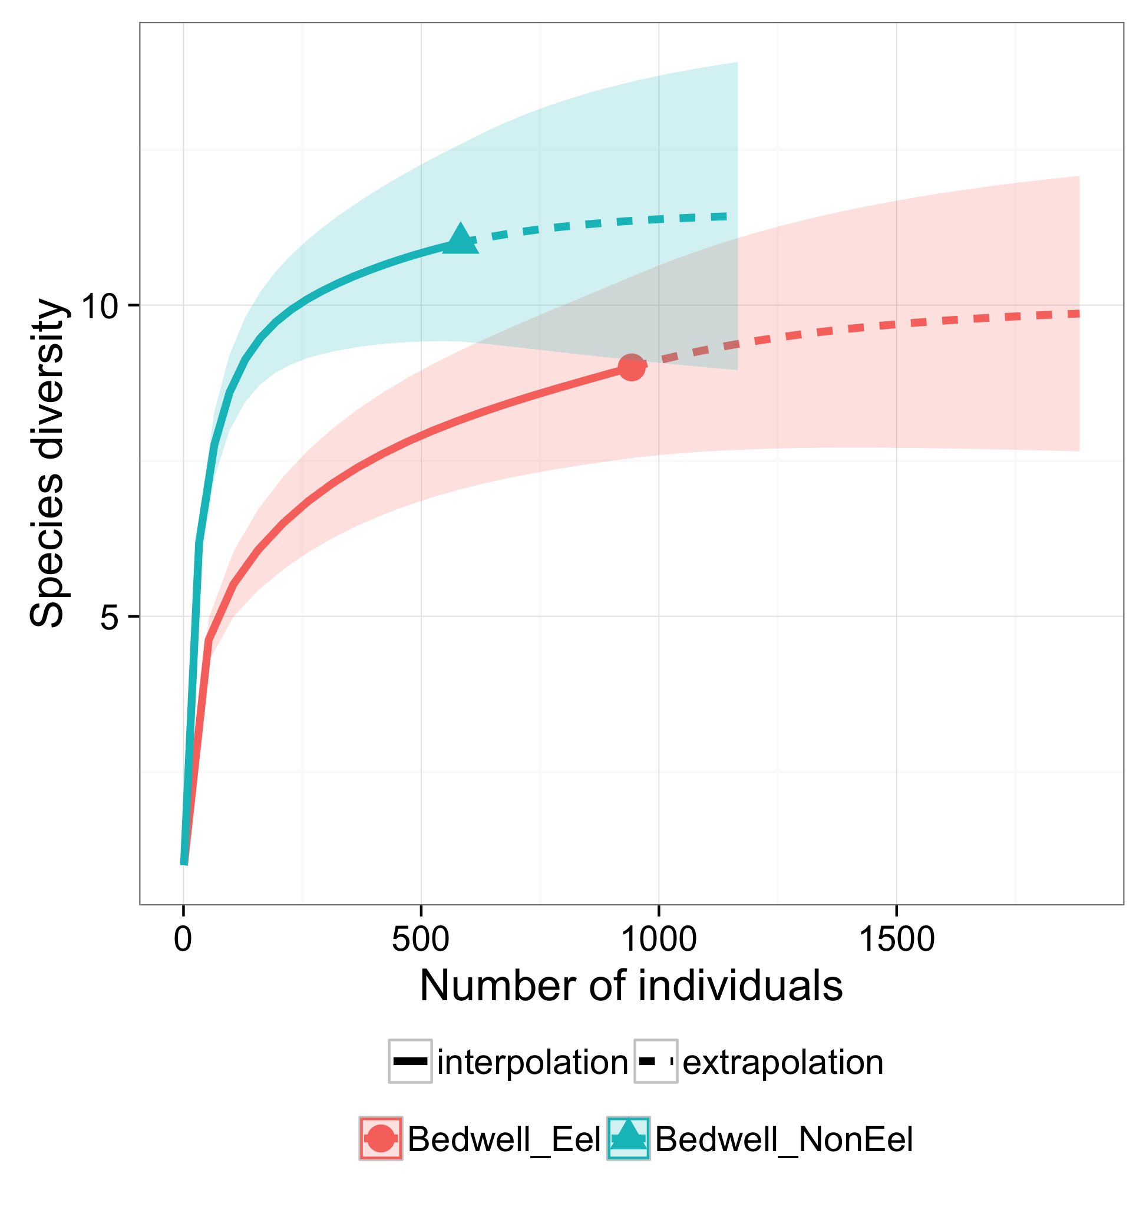

Slide 10
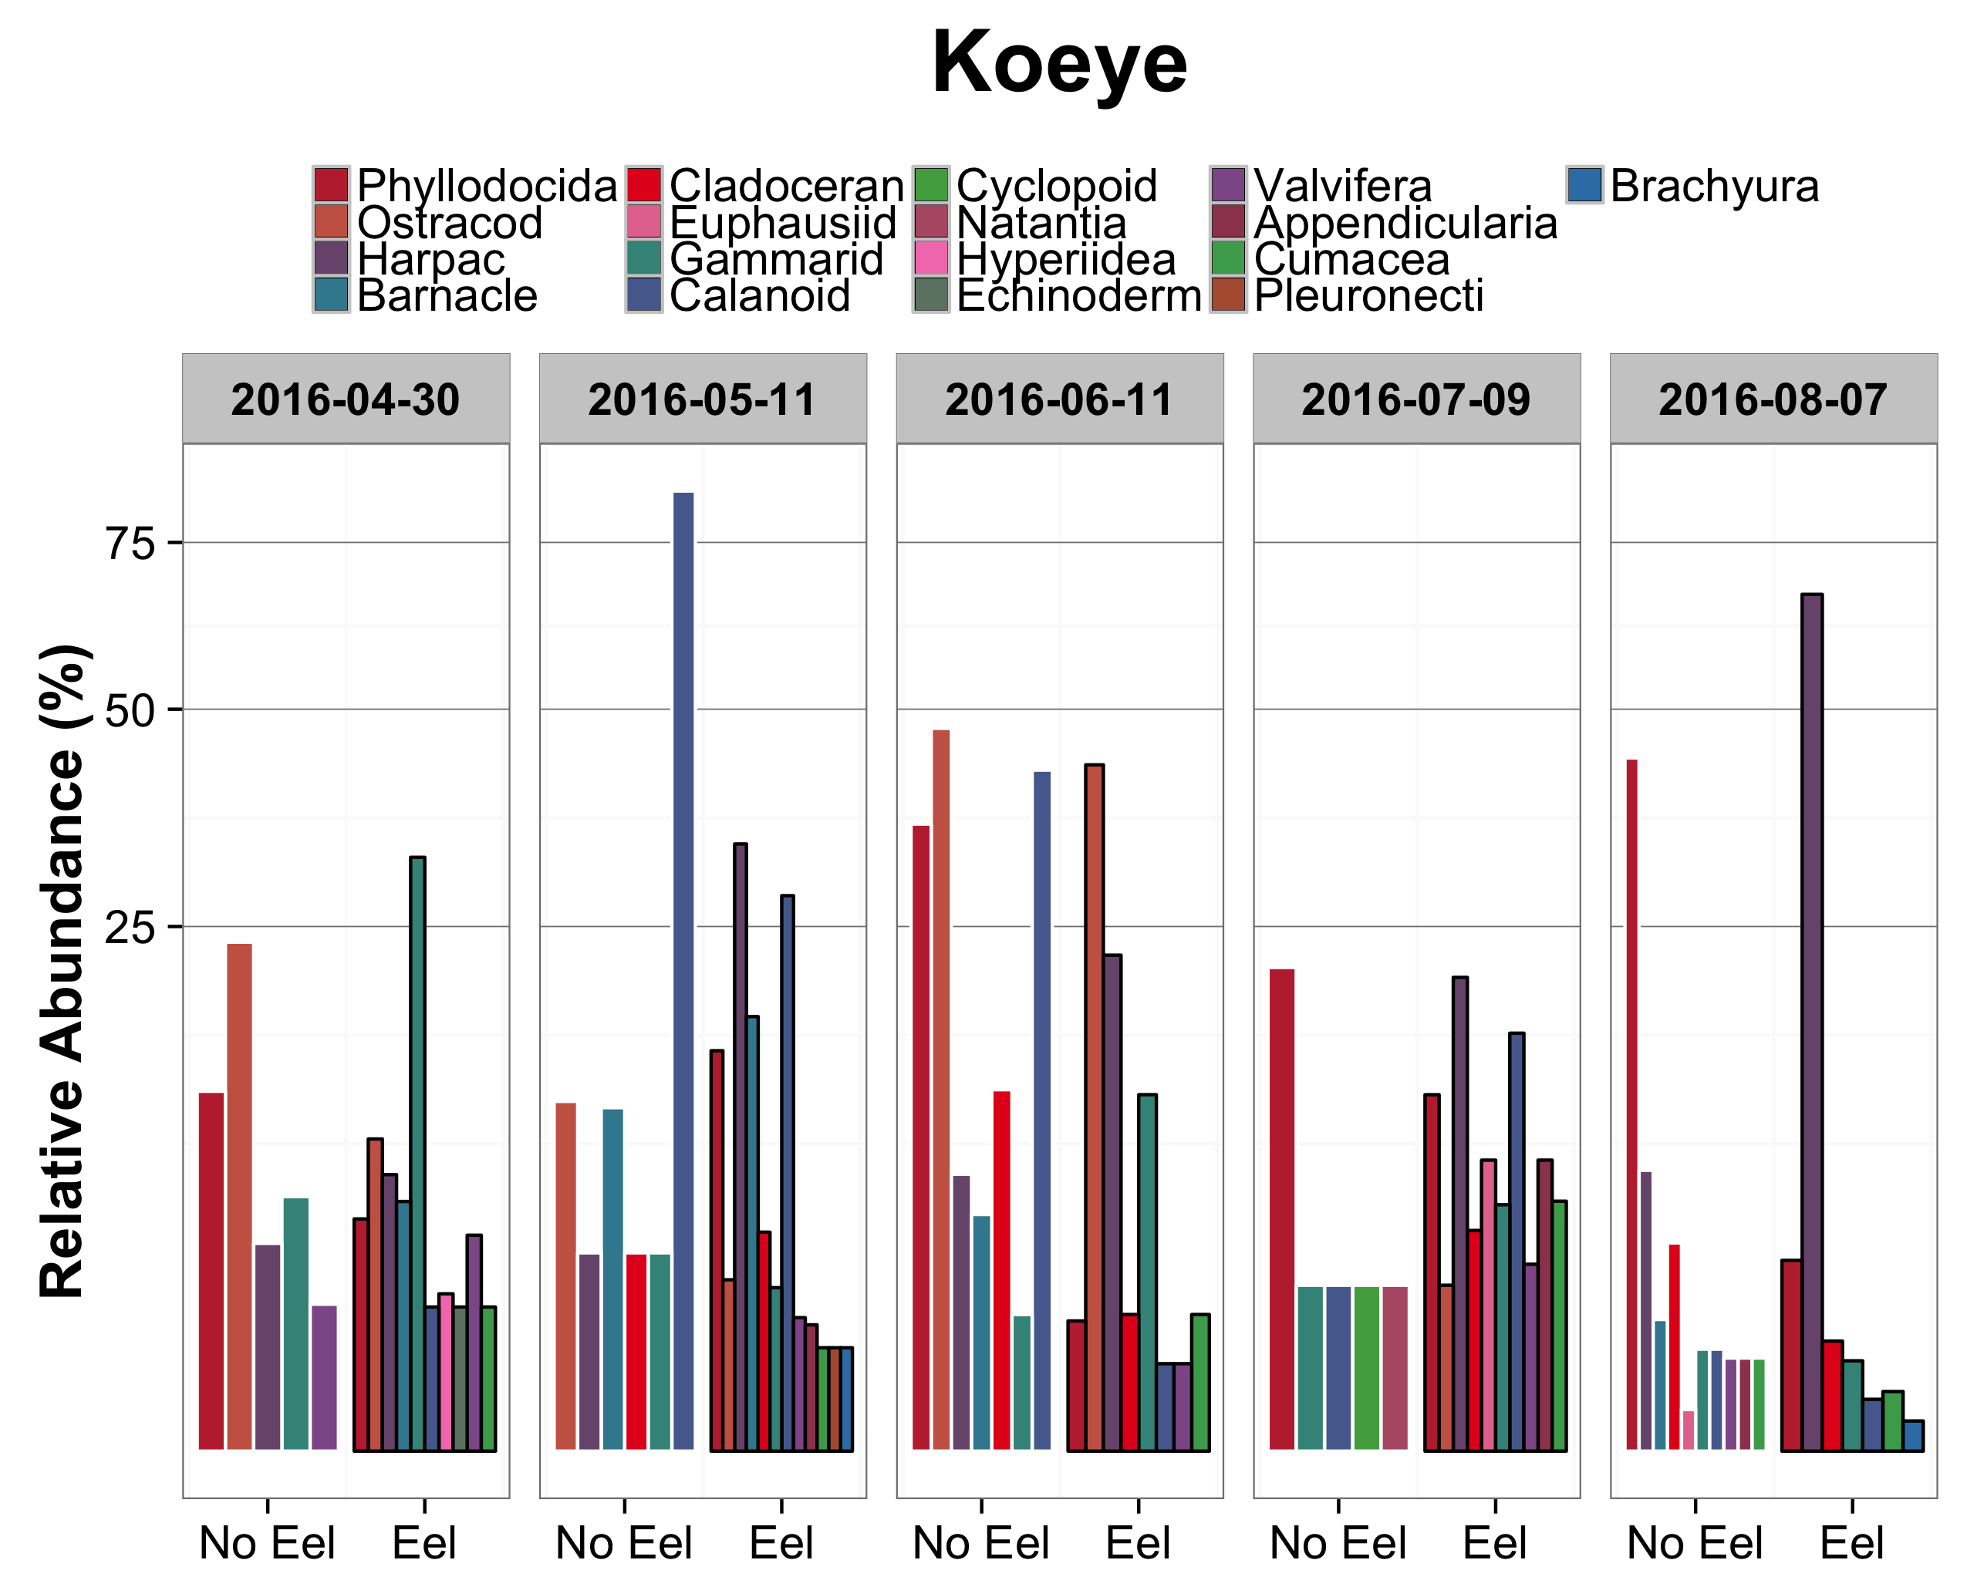

Slide 11
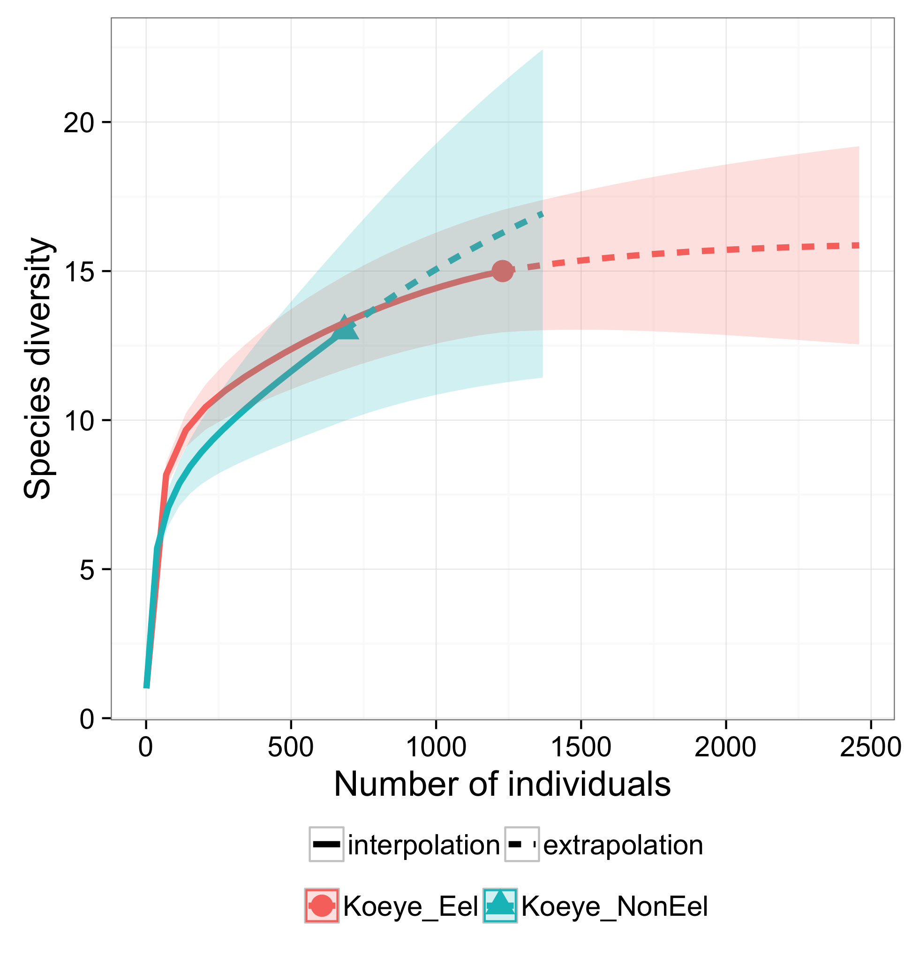

Slide 12
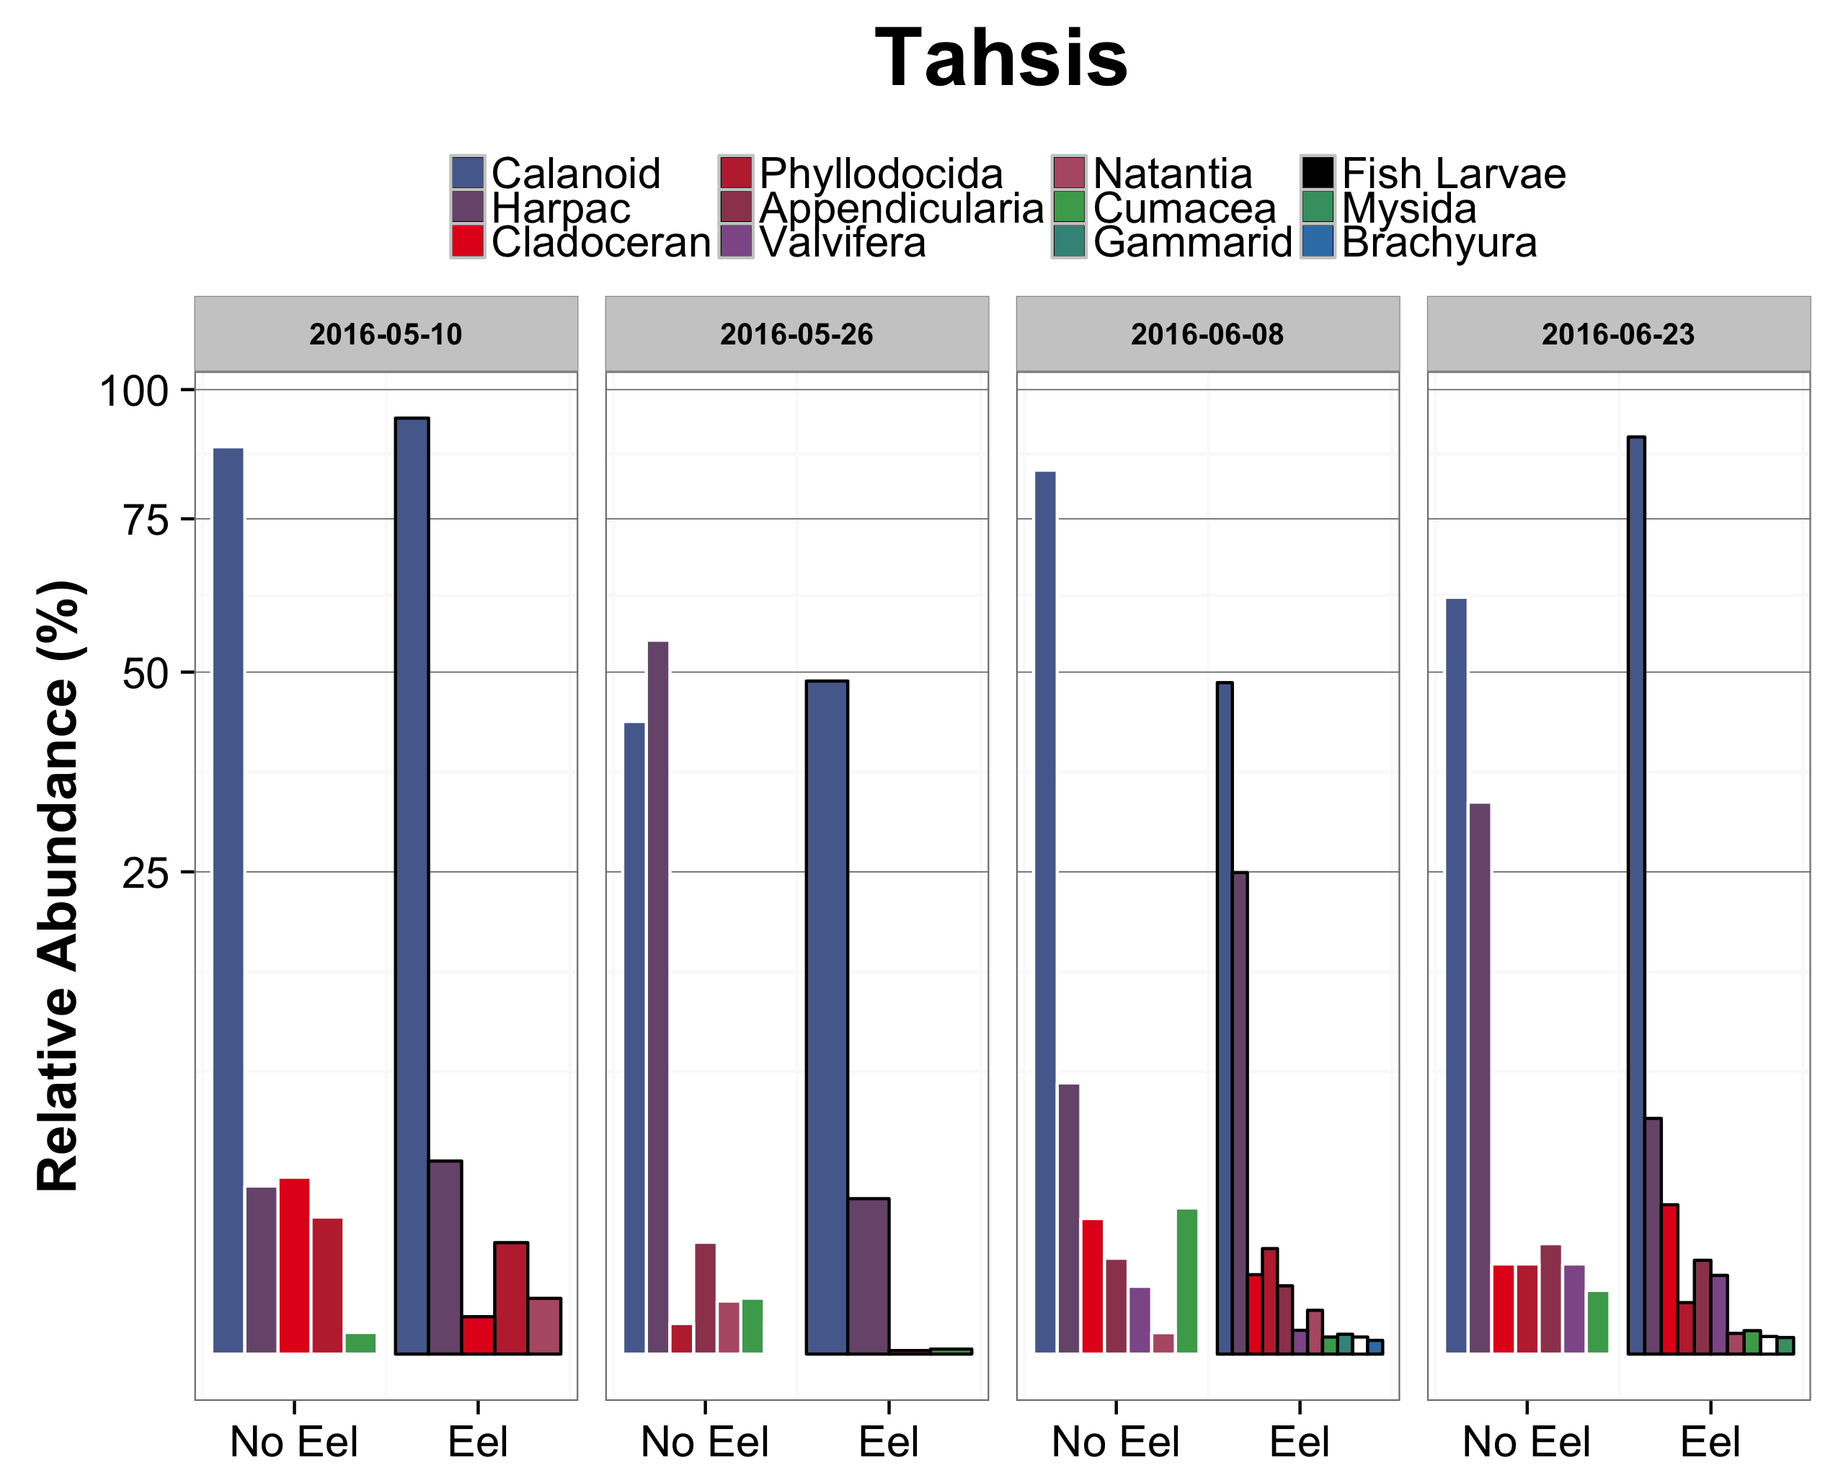

Slide 13
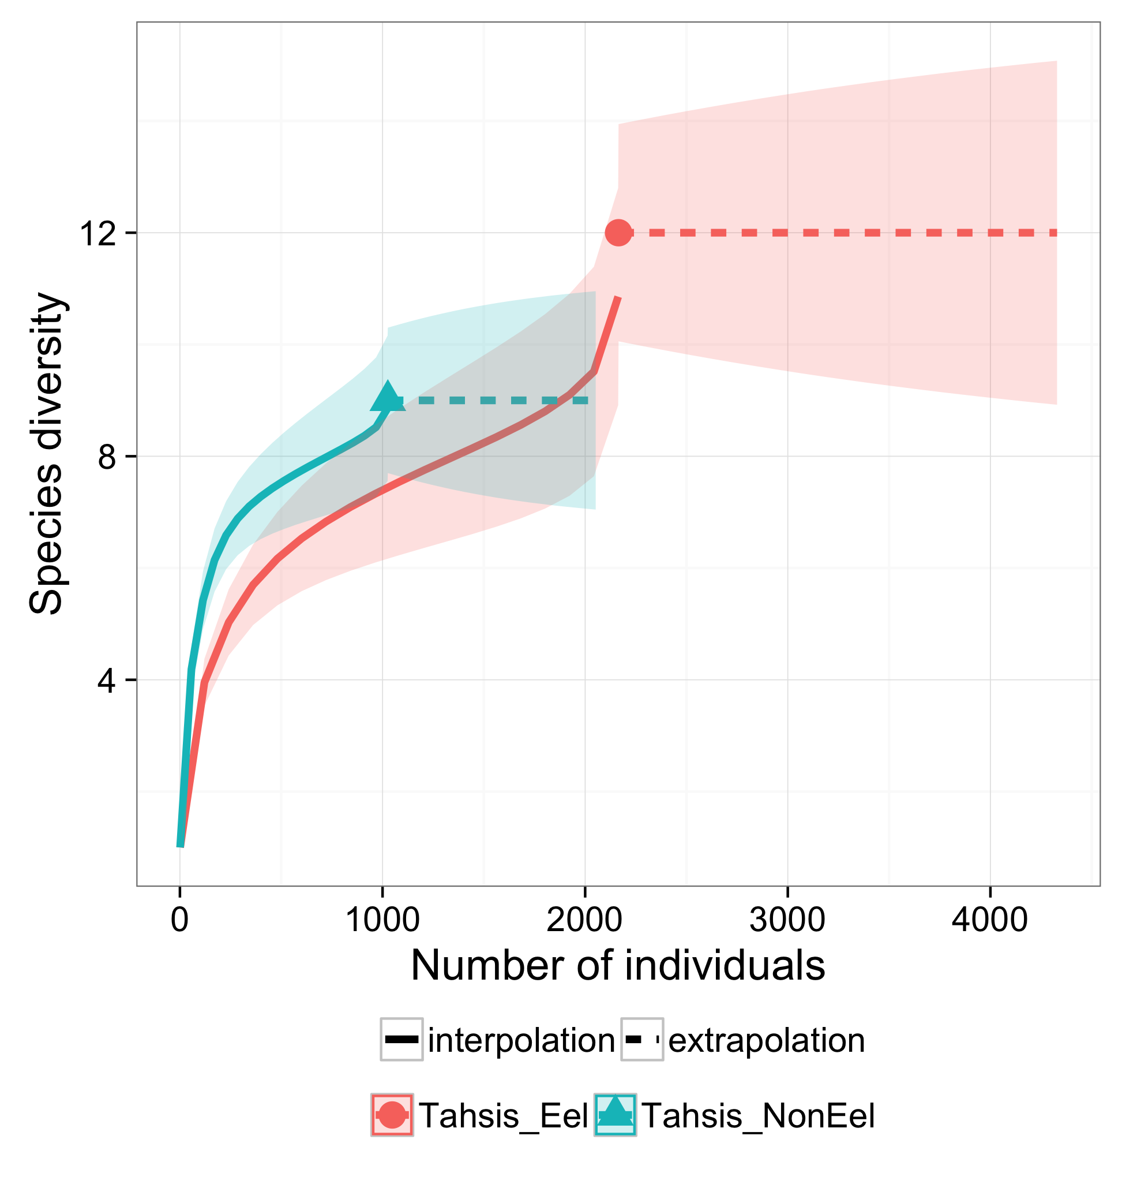

Slide 14
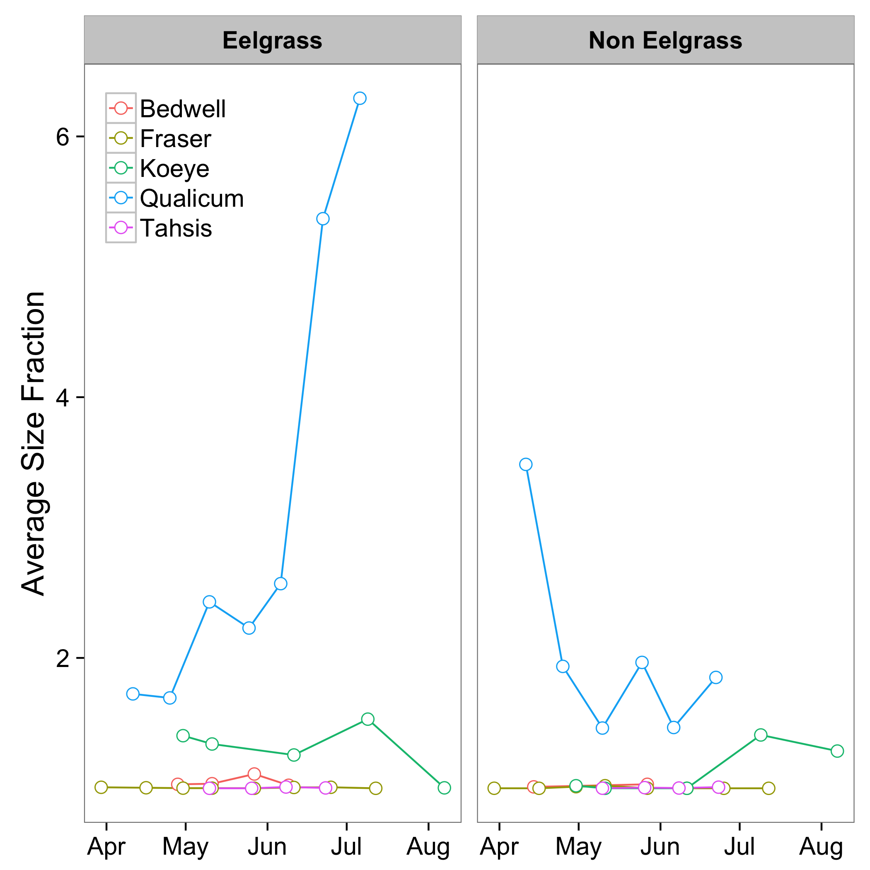

Slide 15
Summary
Site | Dominant Species | Richness* | Evenness* | Avg. Size (mm) | Shift w/ time | Eelgrass effect?
Qualicum | Gammarid? | 1 | 1 | >2 | ? | ?
Fraser | Calanoid | 2 | 3 | ~1 | ? | ?
Bedwell | Harpacticoid | 3 | 3 | ~1 | ? | ?
Koeye | Phyllodocida | 2 | 2 | 1-2 | ? | ?
Tahsis | Calanoid | 3 | 5 | ~1 | ? | ?
Notes:
Done visually, evenness was roughly done by looking at the proportion of sites that had a single species have a majority of the relative abundance.
Richness looked at by comparing the witnessed values

Slide 16
Notes and Future Directions
Are species richness/evenness actually low?
Details/Time Spent Trade-Off
NMDS
Replicates available for further evaluation
More statistical tests to determine relationships
Use Pet Jars, more Ethanol, consistent labelling
Notes:
Looking at higher taxonomic levels, hard to state species
richness low at site when could actually be numerous species, like look at sites with calanoid species.
Compromise for time spent and detail

Slide 17
Resources Used
Al Lewis Key to Harpacticoids associated with Eelgrass in Lower Mainland
Light and Smith Manual
Amphipacifica
Nicole Knight Guide to Fauna Associated with Eelgrass (O’Connor Lab)
http://projectzosteraubc.weebly.com/invertebrate-identification-key.html
Mysids and Euphausids of the Pacific
Thank you to Brian Hunt and Josie Iaceralla for the support!
Notes:
Looking at higher taxonomic levels, hard to state species
richness low at site when could actually be numerous species, like look at sites with calanoid species.
Compromise for time spent and detail

Slide 18
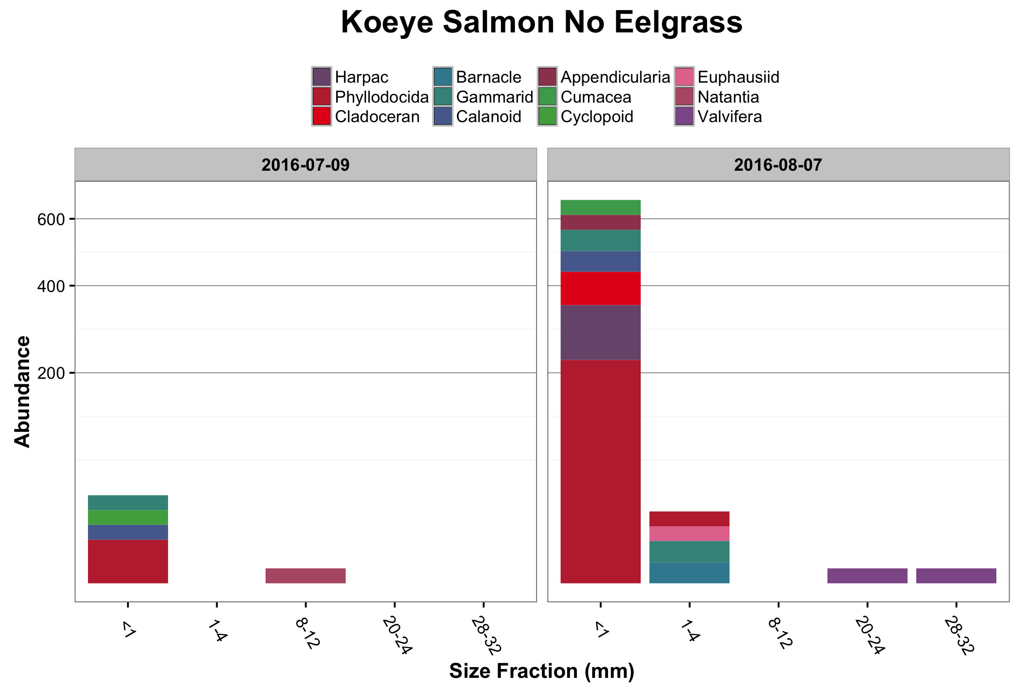

Slide 19
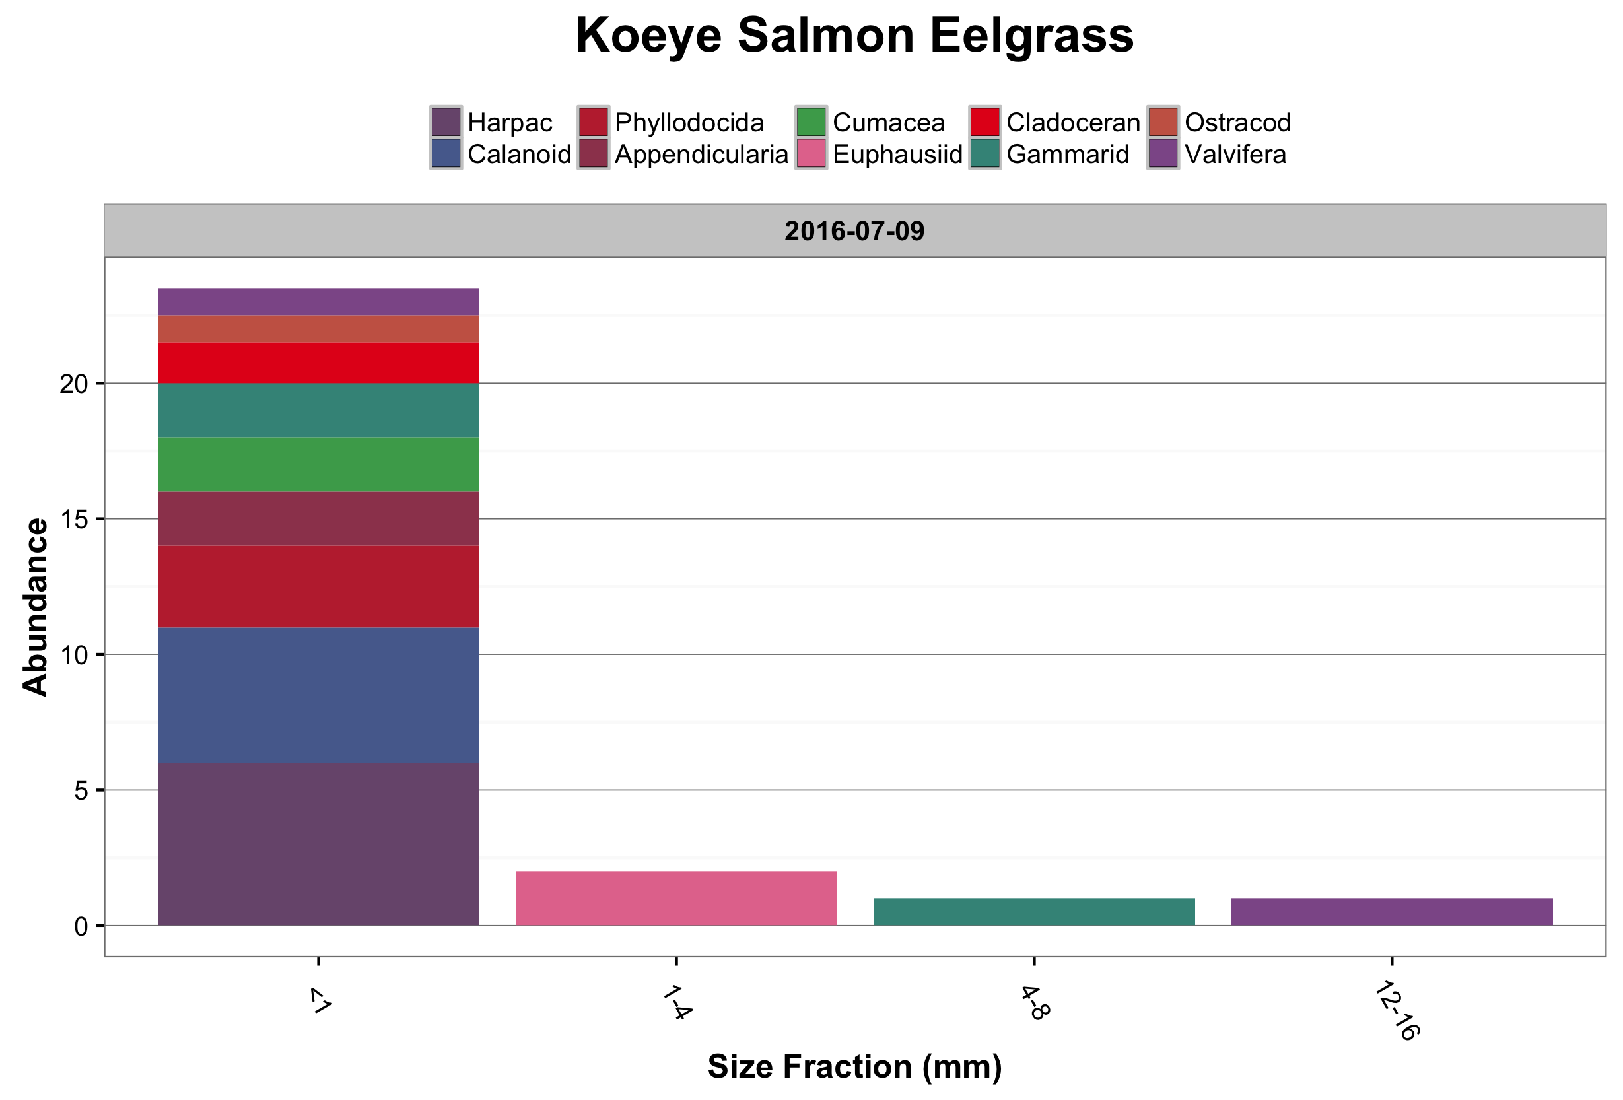

Slide 20
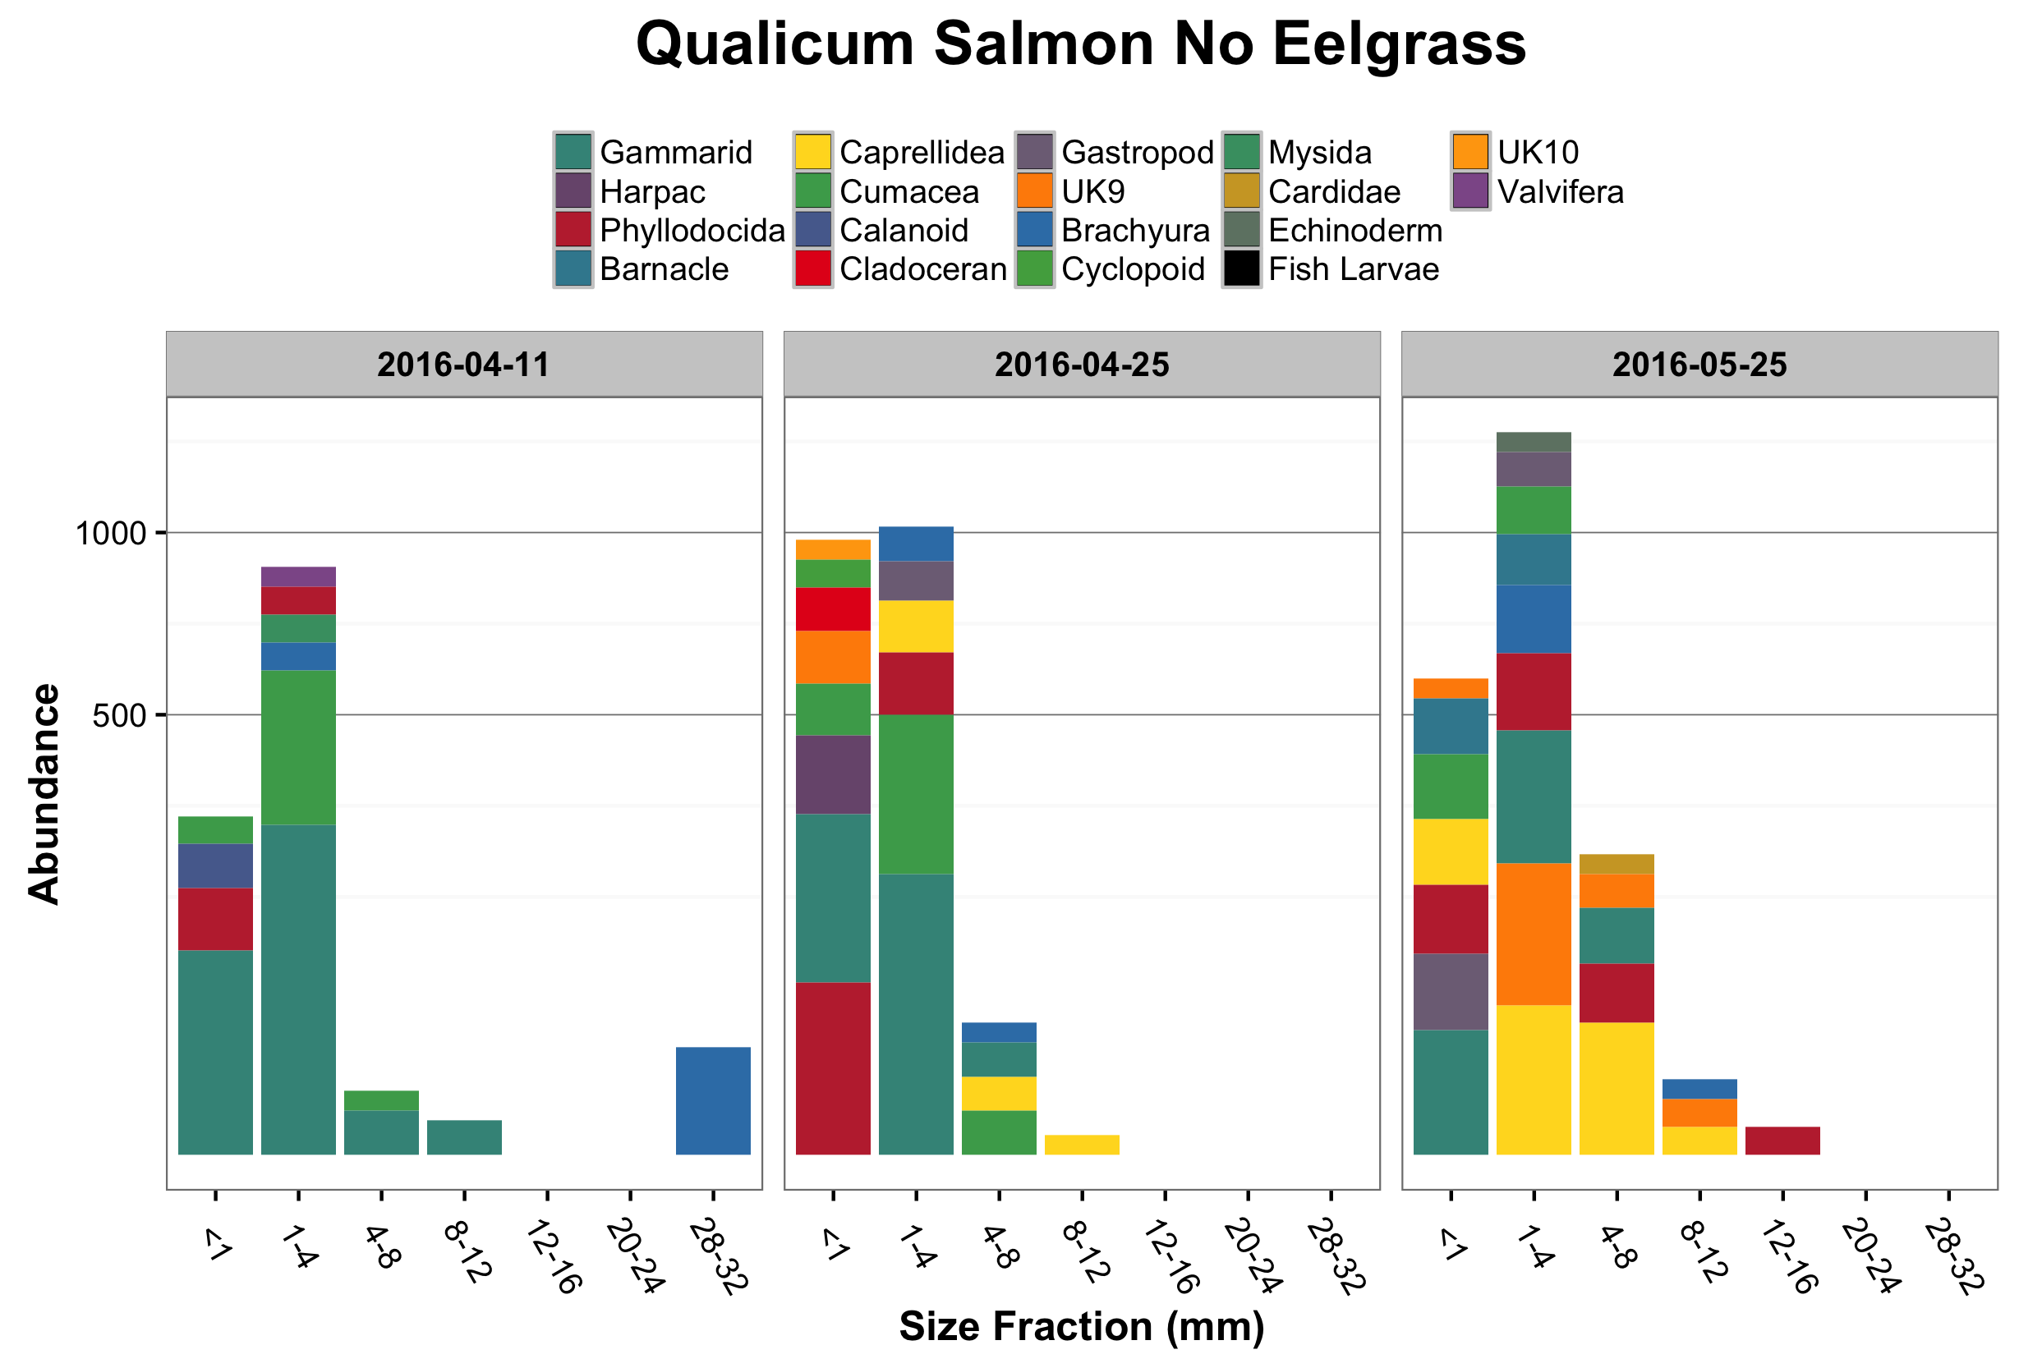

Slide 21
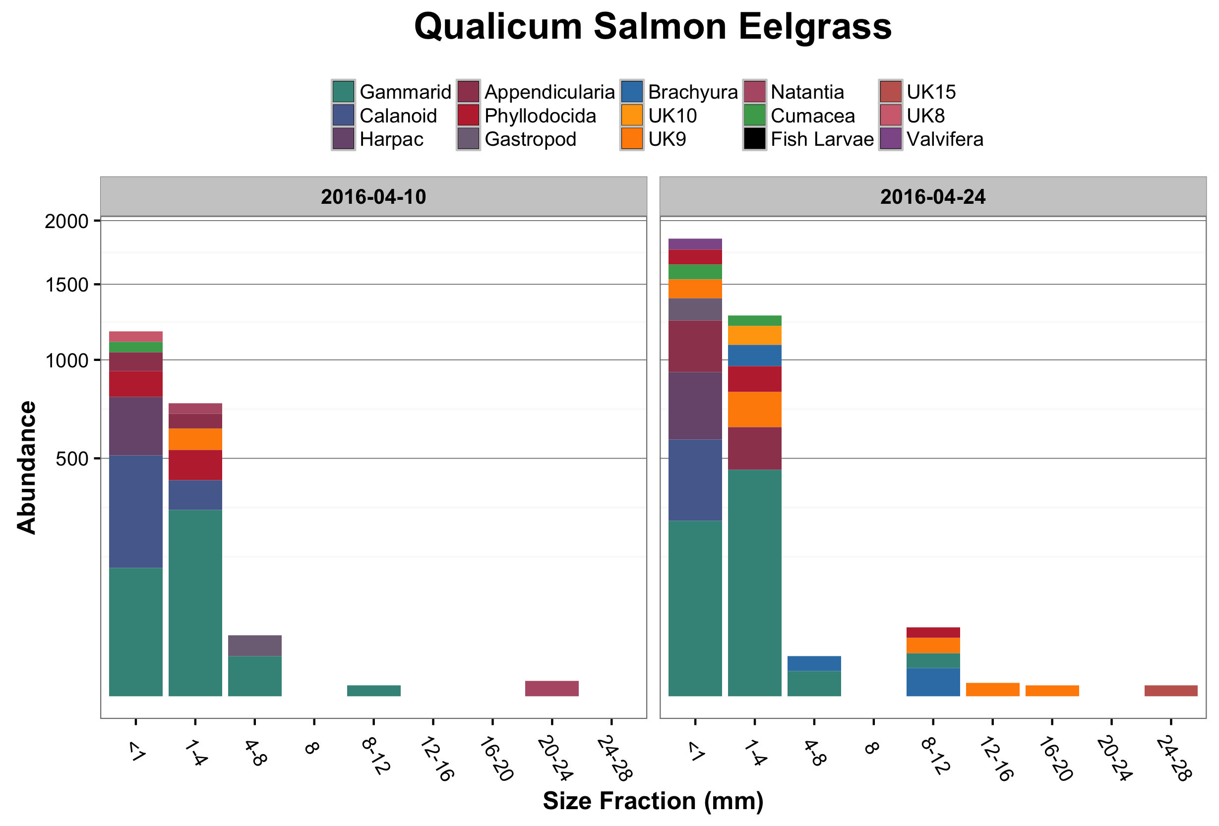

Slide 22
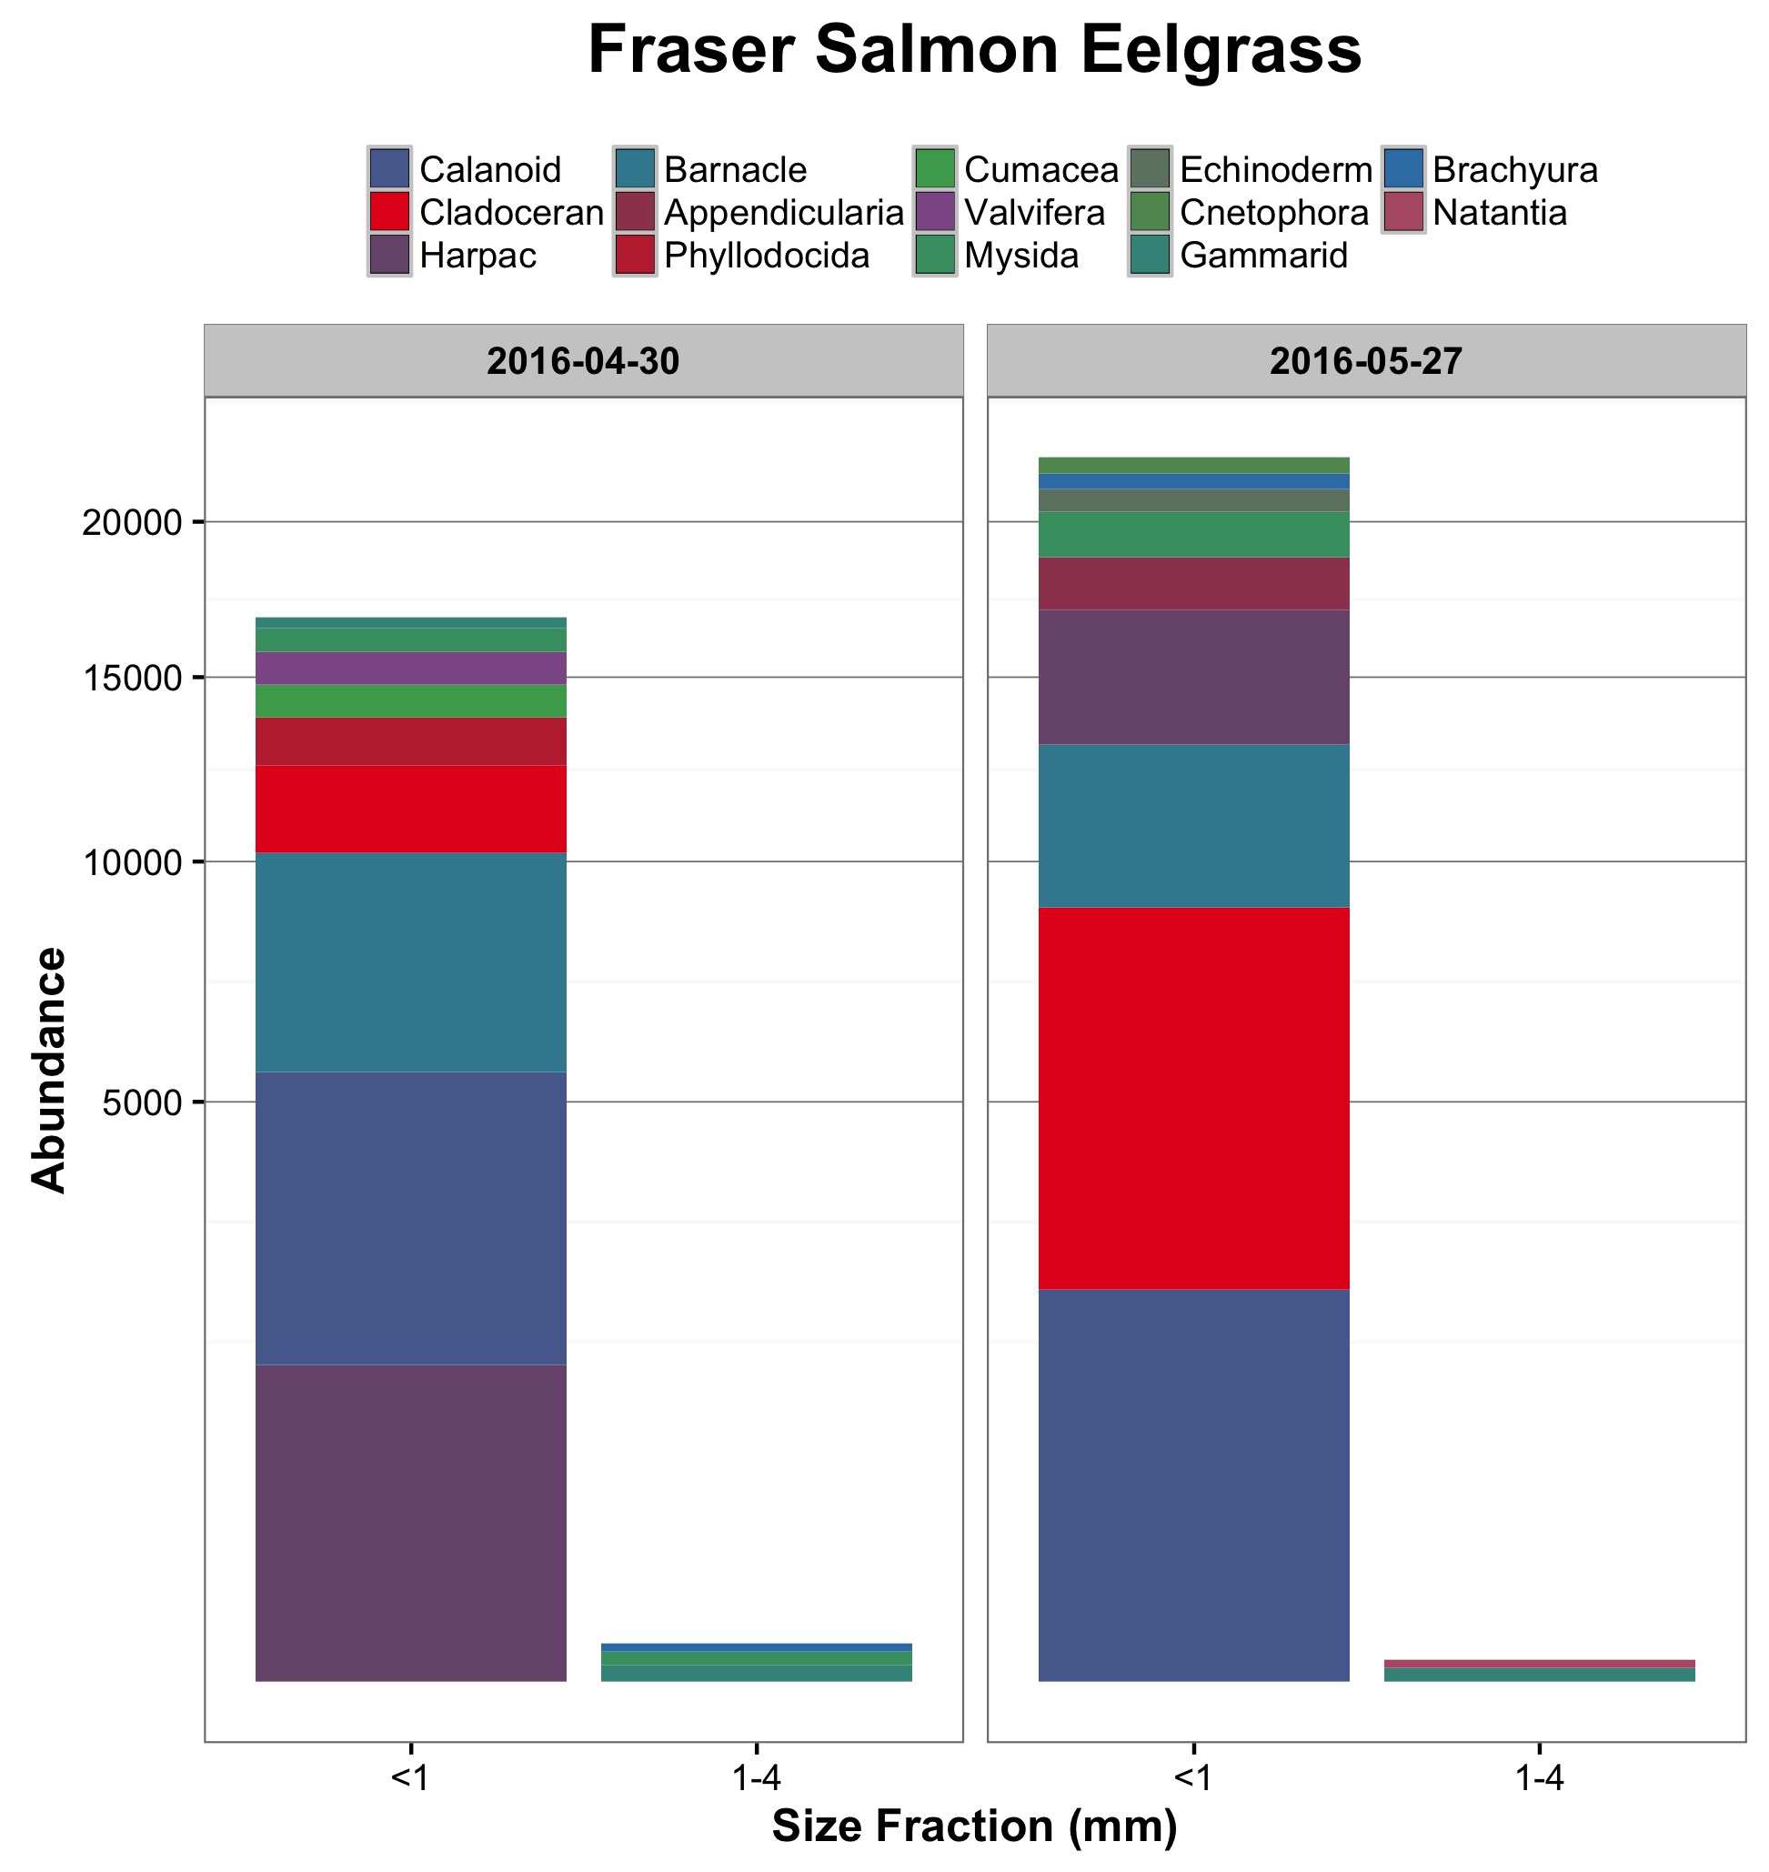

Slide 23
